Slide 1
Functional View
Predictive
Upload Dataset through UI
Select Features/Class from Dataset
Select Machine Learning Technique -Supervised Unsupervised
Select M/C Learning Model e.g. Regression, Clustering
Display Prediction Metrics - Accuracy, MSE, R Square, Top 10
Descriptive
Upload Dataset
Tableau Story to visualize dataset
Add insights as appropriate

Slide 2
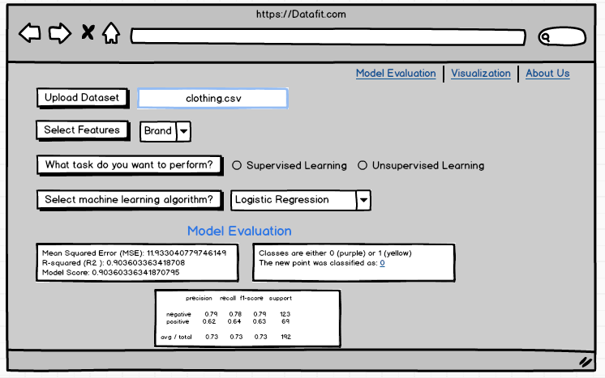
Note : Connect to Tableau
Note : Dropdown to multi select the column names from dataset.
Note : Populate the dropdown based on m/c
Learning technique
Note : This section will be populated with the
output from app.py and JS.

Slide 3
Technical View
App.py
Flask Server
Execute M/C Learning Models
Routes
Logic.js
Access routes from app.py and attach to HTML elements
Capture and Trigger Actions from UI
3 tabs for navigation
Display Model Evaluation Metrics
Connect to Tableau Visualization
HTML/CSS
Bootstrap
Tableau
Brand vs Size/Fit
Brand vs Feedback
Size vs Physical Attributes

